Slide 1
AMBA 3 AHB-Lite Bus Architecture

Slide 2
Module Syllabus
Basic Principles of Buses
Main Features of Arm AMBA Bus Families
AMBA 3 AHB-Lite Bus
Hardware Architecture
Operation Principles

Slide 3
Building a System on a Chip
Software high-level
application development
Application Design (e.g., Game)
Application Programming Interface (API)
Software low-level drivers & libraries programming
Arm CMSIS-Core
Peripheral Drivers
Arm Cortex-M0
Processor
Timer
Peripheral
GPIO
Peripheral
7-segment
Peripheral
Hardware design
AHB
Memory
VGA
Peripheral
UART
Peripheral
Notes:
One of the most important aspects of a system on a chip (SoC) is not only which components or blocks it houses, but also how they interconnect.
So far, we have studied the hardware architecture of the Cortex-M0, its instructions set, and its main power-saving features. This module will focus on learn the basic principles of the Arm AHB bus. A bus is a very important part of the SoC design, as it allows the processor to communicate with other parts of the system, such as memory blocks, peripherals, and application-specific logic.

Slide 4
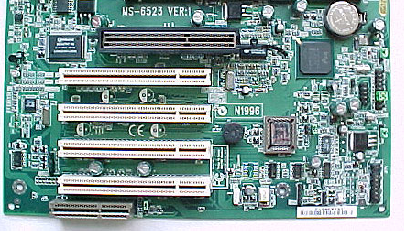
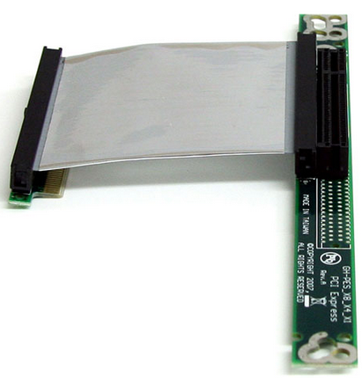
What Is a Bus?
Traditionally, a bus is a communication system that allows data to be transferred between different components in a system.
Hardware and software infrastructure are involved:
Hardware infrastructure includes physical implementation, such as cables or wires; e.g., the PCI uses a PCI cable to connect components inside a desktop.
Software infrastructure includes the bus protocol, e.g., the PCI bus protocol.
PCI socket on a motherboard
PCI bus cable
Notes:
A basic building block of most on-chip communication architectures in SoC designs is the single shared bus.
The simplest bus design consists of a set of shared, parallel wires to which various components are connected, where only one component on the bus can have control of the shared wires at any given time to perform data transfers. Such a simple bus design limits the parallelism and achievable performance in the system, which makes it unsuitable for most SoC applications. Therefore, more advanced solutions are usually employed in such systems. One of these is the AMBA bus, which we will discuss today.
The bus design specification includes both hardware and software infrastructures. The hardware infrastructure includes the physical implementation, such as cables or wires. For example, the PCI uses a PCI cable to connect components inside a desktop. Software infrastructure includes the bus protocol, e.g., PCI bus protocol.

Slide 5
Bus Terminology
Master
Slave 1
Address
Decoder
Slave 2
Multiplexor
Select
Slave 3
Slave
Multiplexor
Notes:
In this diagram, we can see an example of a bus design. There are some terms that are typically used in the specifications of on-chip buses, and it is important to be familiar with the terminology used.
A “master” (or initiator) refers to the IP component that initiates a read or write data transfer (e.g., processor or DSP).
A “slave” (or target) refers to the IP component that does not initiate transfers and only responds to incoming transfer requests (e.g., memory block).
A “decoder” refers to a logic block that decodes the destination address of a data transfer initiated by a master, and selects the appropriate slave to receive the data.
A multiplexor is used to multiplex the read data bus and response signals from the slaves to the master. The decoder provides control for the multiplexor.

Slide 6
Bus Operation in General
A bus typically consists of three types of signal lines:
The data bus is used to exchange data information.
The address bus is used to select one of the peripherals (or one register of a peripheral).
Control signals are used to synchronize and identify transactions, such as ready, write/read, and transfer mode signals.
System on Chip
Master
(microprocessor)
32-bit Address bus
32-bit Data bus
Slave 1
Slave 2
Slave 3
Slave 4
Slave 5
Slave 6

Slide 7
A Typical Bus Operation Example
Processor
Peripheral
The following steps illustrate a typical operation to access a peripheral:
The master (e.g., a processor) selects one peripheral (or one register) by giving the address to the address bus. At the same time, it sets control signals, such as read or write and transfer size.
Address bus
Select a peripheral
Control bus
Read operation, transfer size at the same time

Slide 8
A Typical Bus Operation Example
Processor
Peripheral
The following steps illustrate a typical operation to access a peripheral:
The master (e.g., a processor) selects one peripheral (or one register) by giving the address to the address bus. At the same time, it sets control signals, such as read or write and transfer size.
The master waits for the slave (e.g., peripheral) to respond.
Address bus
Select a peripheral
Control bus
Read operation, transfer size at the same time

Slide 9
A Typical Bus Operation Example
Processor
The following steps illustrate a typical operation to access a peripheral:
The master (e.g., a processor) selects one peripheral (or one register) by giving the address to the address bus. At the same time, it sets control signals, such as read or write and transfer size.
The master waits for the slave (e.g., peripheral) to respond.
Once the slave is ready, it sends back the requested data to the processor. At the same time, it sets the ready signal on the control bus.
Address bus
Select a peripheral
Control bus
Read operation, transfer size at the same time
Data bus
Send data back to processor
Control bus
Set ready signal at the same time

Slide 10
A Typical Bus Operation Example
Processor
Peripheral
The following steps illustrate a typical operation to access a peripheral:
The master (e.g., a processor) selects one peripheral (or one register) by giving the address to the address bus. At the same time, it sets control signals, such as read or write and transfer size.
The master waits for the slave (e.g., peripheral) to respond.
Once the slave is ready, it sends back the requested data to the processor. At the same time, it sets the ready signal on the control bus.
Finally, the master reads the transmitted data and starts another communication cycle.
Address bus
Select a peripheral
Control bus
Read operation, transfer size at the same time
Data bus
Send data back to processor
Control bus
Set ready signal at the same time
Processor reads the data and starts the next operation
Address bus
Select a peripheral

Slide 11
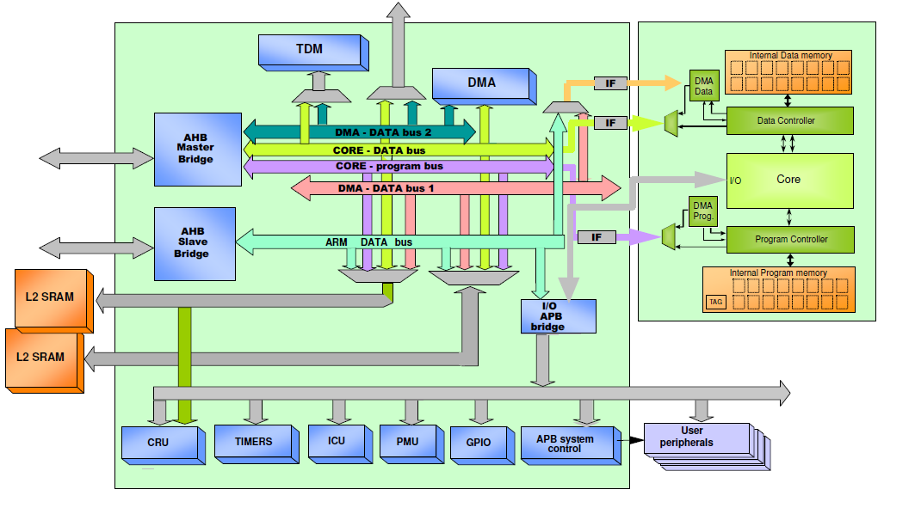
Communication Architecture Standards
Why do we need communication standards?
Modular design approach
Allows design reuse
Facilitates IP integration into an SoC design
Picture source: http://www.ecs.soton.ac.uk/ (SoC Advance design Technique)
Notes:
Modern SoCs need to handle incompatible IP interfaces. Assembling heterogeneous IPs for SoC design can take months. Interface and communication standards define a specific data transfer protocol and decide the number and functionality of pins at IP interfaces, which makes it easy to connect diverse IPs quickly.
So, in summary, communication standards can encourage modular system design and IP reuse, make the design of IP cores independent of the system design, and facilitate the integration of IP cores from different vendors.

Slide 12
Arm AMBA System Bus
AMBA: Advanced microcontroller bus architecture
AMBA protocol is an open standard on-chip interconnect specification.
Provides the interface standard that enables IP reuse
Facilitates right-first-time development of multiprocessor designs with large numbers of controllers and peripherals
Widely used in modern portable mobile devices, such as tablets and smartphones

Slide 13
Arm AMBA Bus Families
AMBA family | Bus protocol
AMBA 5 | CHI
AMBA 4 | ACE, ACE-Lite
 | AXI4, AXI4-Lite, AXI4-Stream
AMBA 3 | AXI
 | AHB (AHB-Lite)
 | APB
 | ATB
AMBA 2 | AHB, APB
AMBA 1 | ASB, APB
Notes:
There are five families of AMBA specifications (AMBA 1, 2, 3, 4, and 5), which are developed to meet different requirements.
AMBA 1 defines two buses: advanced system bus (ASB) and advanced peripheral bus (APB).
AMBA 2 introduces the AHB (advanced high-performance bus) and the APB (advanced peripheral bus). The AHB was intended to be the main system bus in microcontroller usage, and the APB was developed for peripherals connection and designed to take up a minimal area.
AMBA 3 defines four buses (AXI, AHB, APB, and ATB). AMBA 3 AHB and APB specifications have the same usage as in the previous version. AMBA 3 AXI was developed to support high data throughput. AMBA 3 ATP facilitates moving trace data around the chip.
AMBA 4 adds another five bus protocols as shown in this table. AXI4 is an update to AXI3 to enhance the performance and utilization of the interconnect when used by multiple masters. ACE (AXI coherency extensions) is widely used on the latest Arm Cortex-A processors including Cortex-A7 and Cortex-A15.
In this course, we will be using the AMBA 3 AHB-Lite interface to build our SoC.

Slide 14
AMBA 3 AHB-Lite Bus
AHB
High-performance synthesizable designs
Supports multiple bus masters
Provides high-bandwidth operation
AHB-Lite:
A subset of AHB
Simplifies the design of AHB bus, e.g., typically with a single master
Notes:
The AHB is a high-performance synthesizable design, which supports multiple bus masters and provides high-bandwidth operation. AHB supports connections of on-chip and off-chip memory blocks. AHB-Lite is a subset of the AHB specifications, designed for single master systems with simple peripherals.

Slide 15
AHB-Lite Bus Block Diagram
Master
CONTROL
HWDATA [31:0]
Slave 1
HADDR [31:0]
Address
Decoder
HSEL_1
HSEL_2
Slave 2
HSEL_3
Multiplexor
Select
Slave 3
HRDATA_3 [31:0]
HRDATA
[31:0]
RESPONSE_3
Slave
Multiplexor
HRDATA_2 [31:0]
RESPONSE
RESPONSE_2
HRDATA_1 [31:0]
RESPONSE_1
Notes:
This diagram shows a single master AHB-Lite system design with one AHB-Lite master and three AHB-Lite slaves. The decoder block is controlled by the master that specifies which slave must be selected. The multiplexor block is controlled by the decoder that chooses which slave output data must be connected to the master.
The most common AHB-Lite slaves are internal memory devices, external memory interfaces, and high-bandwidth peripherals.

Slide 16
AHB-Lite Master Interface
The AHB-Lite master provides address and control information to initiate read and write operations.
The master also receives the response from the slave, including data and ready and response signal.
Master
HWRITE
Transfer response
HREADY
HSIZE [1:0]
HRESP
HBURST [2:0]
CONTROL signals
Global signals
HPROT [3:0]
HRESETn
HTRANS [1:0]
HCLK
HMASTLOCK
HADDR [31:0]
Address
Data
HRDATA [31:0]
Data
HWDATA [31:0]
Notes:
The master block generates three types of output signals: address, data, and control signals, which include the following: HWRITE (the transfer direction); HSIZE (the size of the transfer); and HTRANS (transfer type), which can be IDLE, BUSY, NONSEQUENTIAL, or SEQUENTIAL.
There are other signals. More detailed information on these can be found in the AHB-Lite reference manual.
There are three types of input signals that can be received by the master block. These are data signals; transfer response signals from the decoder, which indicates that the previous transfer is complete; and global signals, which include the clock and the reset signals.

Slide 17
AHB-Lite Slave Interface
An AHB-Lite slave responds to transfer initiated by the master in the system.
The signal HSELx is the output from the address decoder, which is used to select one slave at a time.
Select signal
HSELx
Slave x
HWRITE
HSIZE [1:0]
HREADYOUT
Transfer response
CONTROL signals
HBURST [2:0]
HRESP
HPROT [3:0]
HTRANS [1:0]
HMASTLOCK
HREADY
HRDATA [31:0]
Data
Address
HADDR [31:0]
Data
HWDATA [31:0]
Global signals
HRESETn
HCLK
Notes:
The slave block receives five types of input signals:
Address
Data
Global signals (e.g., clock and reset)
Select signal
Other control signals from the master
There are two types of output signals generated by the slave: data and transfer response signals. The latter includes HREADYOUT and HRESP. Both signals are intended for the master block and carry information about the status of the transfer.

Slide 18
Address Decoder
Address decoder
Selects one of the slaves depending on the current address bus
Also informs the slave multiplexor
Address
Decoder
Multiplexor select
HSEL_1
HADDR [31:0]
HSEL_2
HSEL_3
Notes:
The address decoder selects one of the slaves depending on the current address bus available on its HADDR inputs. The logic value of HSELx signal is calculated by decoding the address bus using combinatorial logic.
The address decoder also informs the slave multiplexor using the multiplexor select output signal.

Slide 19
Slave Multiplexor
Slave multiplexor
Inputs the response signals (HRDATA, HREADY, and HRESP) from all the slaves, and outputs one of them depending on the selecting signal from the address decoder.
Address
Decoder
Multiplexor Select
HRDATA_1
RESPONSE_3
HREADY
HSEL_1
HRDATA_2
Slave
Multiplexor
HRESP
HADDR [31:0]
RESPONSE_2
HRDATA
[31:0]
HSEL_2
HRDATA_3
HSEL_3
RESPONSE_1
Notes:
The inputs of this block are the response signals (HRDATA, HREADY, and HRESP) from all the slaves. This block chooses the response signals from one slave to send to the master. This choice is controlled by a selecting signal from the address decoder.

Slide 20
Hardware Implementation
Due to the pipelined operation, some signals have to be deliberately delayed:
The selecting signals from the decoder to the multiplexor are delayed for one clock cycle.
The HREADY signal is delayed for one clock cycle before it is fed back to the multiplexor.
The detailed implementation can be referred from the code that is provided in the EDK.
Flip-flop
Address
Decoder
Multiplexor Select
HRDATA_1
RESPONSE_3
HREADY
HSEL_1
HRDATA_2
Slave
Multiplexor
HRESP
HADDR [31:0]
RESPONSE_2
HRDATA
[31:0]
HSEL_2
HRDATA_3
HSEL_3
RESPONSE_1
Flip-flop

Slide 21
AHB-Lite Operation Principles
AHB-Lite supports three types of transfers:
Single
Incrementing bursts that do not wrap at address boundaries
Wrapping bursts that wrap at particular address boundaries
Notes:
The master starts a transfer by driving the address and control signals. These signals provide information about the address, direction, and width of the transfer, and indicate if the transfer forms part of a burst. Transfers can be single, incrementing bursts that do not wrap at address boundaries, and wrapping bursts that wrap at particular address boundaries.

Slide 22
AHB-Lite Operation Principles
An AHB-Lite transfer consists of two phases:
The address phase, which lasts for a single HCLK cycle unless it is extended by the previous bus transfer.
The data phase might require several HCLK cycles. The HREADY signal is used to control the number of clock cycles required to complete the transfer.

Slide 23
AHB-Lite Bus Timing
This module focuses on the basic bus operation, so we assume the following:
No BURST transaction: HBURST[2:0] is always 3’b000.
Never generates locked transactions: HMASTLOCK is always 1’b0.
All transactions issued are non-sequential transfer: HTRANS[1:0] is either 2’b00 (IDLE) or 2’b10 (non-sequential).
Notes:
More advanced bus transaction can be found in the AMBA 3 AHB-Lite Protocol Specification.

Slide 24
Basic Read Transfer
Consider a simple read transfer with no wait states:
HCLK
CONTROL
Control 0
Control 1
Control 2
Control 3
HADDR [31:0]
Address 0
Address 1
Address 2
Address 3
HRDATA [31:0]
Read Data 0
Read Data 1
Read Data 2
HWRITE
HREADY
Notes:
We start with a basic read transfer.

Slide 25
Basic Read Transfer
Consider a simple read transfer with no wait states:
The address phase: The master drives the address and control signals onto the bus after the rising edge of HCLK.
HCLK
CONTROL
Control 0
Control 1
Control 2
Control 3
HADDR [31:0]
Address 0
Address 1
Address 2
Address 3
HRDATA [31:0]
Read Data 0
Read Data 1
Read Data 2
HWRITE
HREADY
Notes:
The address phase: The master drives the address and control signals onto the bus after the rising edge of HCLK, and clears HWRITE to zero.

Slide 26
Basic Read Transfer
Consider a simple read transfer with no wait states:
The address phase: The master drives the address and control signals onto the bus after the rising edge of HCLK.
The data phase: The slave samples the address and control information and make data available at HRDATA before driving the appropriate HREADY response.
HCLK
CONTROL
Control 0
Control 1
Control 2
Control 3
HADDR [31:0]
Address 0
Address 1
Address 2
Address 3
HRDATA [31:0]
Read Data 0
Read Data 1
Read Data 2
HWRITE
HREADY
Notes:
This response is sampled by the master on the third rising edge of HCLK. This simple example demonstrates how the address and data phases of the transfer occur during different clock cycles. The address phase of any transfer occurs during the data phase of the previous transfer. This overlapping of address and data is fundamental to the pipelined nature of the bus and enables high-performance operation while still providing adequate time for a slave to provide the response to a transfer.

Slide 27
Basic Write Transfer
Consider a simple write transfer with no wait states:
The address phase: The master drives the address and control signals onto the bus after the rising edge of HCLK and sets HWRITE to one.
The data phase: The slave samples the address and control information and make data available at HRDATA before driving the appropriate HREADY response.
HCLK
CONTROL
Control 0
HADDR [31:0]
Address 0
HWDATA [31:0]
Write Data 0
HWRITE
HREADY

Slide 28
Basic Write Transfer
Consider a simple write transfer with no wait states:
The address phase: The master drives the address and control signals onto the bus after the rising edge of HCLK and sets HWRITE to one.
The data phase: The slave samples the address and control information and make data available at HRDATA before driving the appropriate HREADY response.
HCLK
CONTROL
Control 0
HADDR [31:0]
Address 0
HWDATA [31:0]
Write Data 0
HWRITE
HREADY

Slide 29
Read Transfer with Wait State
Address phase (first clock cycle)
Give address and control signals; set HWRITE to one.
Data phase (multiple clock cycles)
The slave holds HREADY to zero if it is not ready to provide its data; the master delays its next transaction.
When the slave is ready, the data will be given at HRDATA; at the same time, HREADY is set to one. The master will then continue its next transaction.
HCLK
CONTROL
Control 0
HADDR [31:0]
Address 0
HRDATA [31:0]
Data 0
HWRITE
HREADY
Notes:
This is a more complicated transfer type.

Slide 30
Write Transfer with Wait State
Address phase (first clock cycle)
Give address and control signals; clear HWRITE to zero.
Data phase (multiple clock cycles)
The master gives its data at HWDATA. The slave holds HREADY to zero if it is not ready to receive the data; the master delays its next transaction.
When the slave is ready, it will receive the data and set HREADY to one. The master will then continue its next transaction.
HCLK
CONTROL
Control 0
HADDR [31:0]
Address 0
HWDATA [31:0]
Data 0
HWRITE
HREADY

